Slide 1
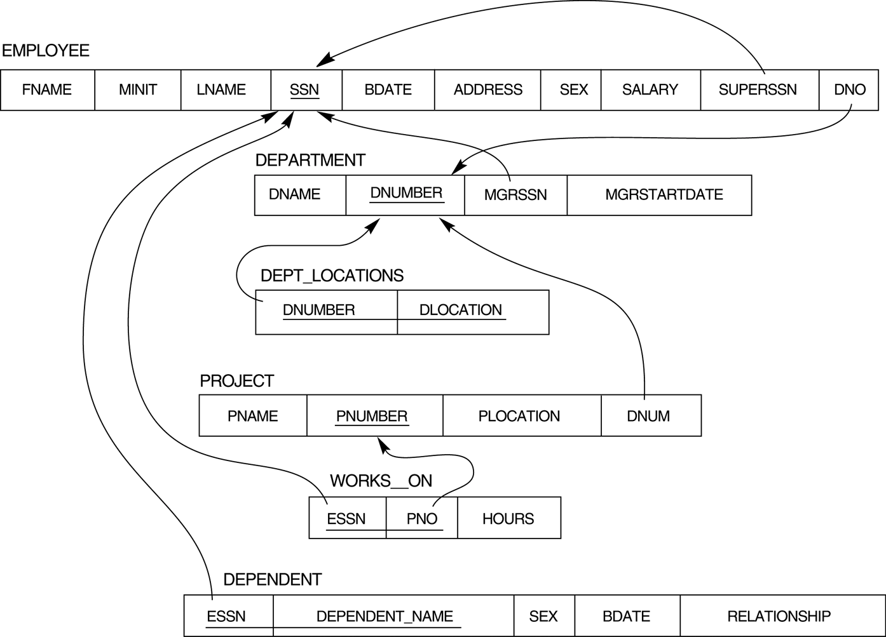
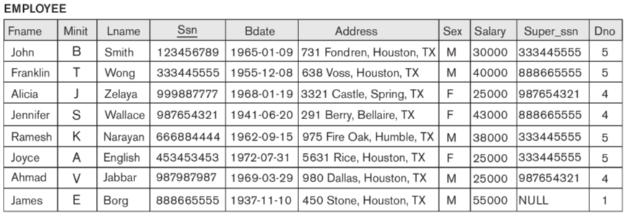
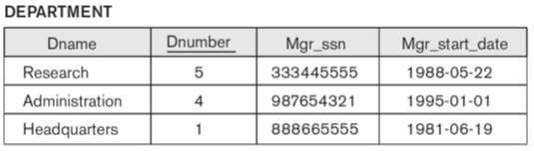
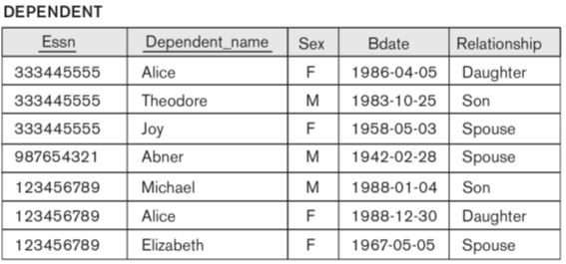
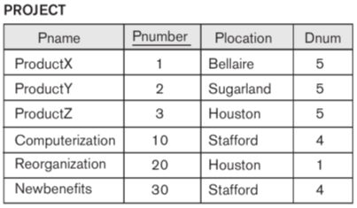
Chapter 3 The Basic (Flat) Relational Model
…
Mini-world
DB
DBMS

Slide 2
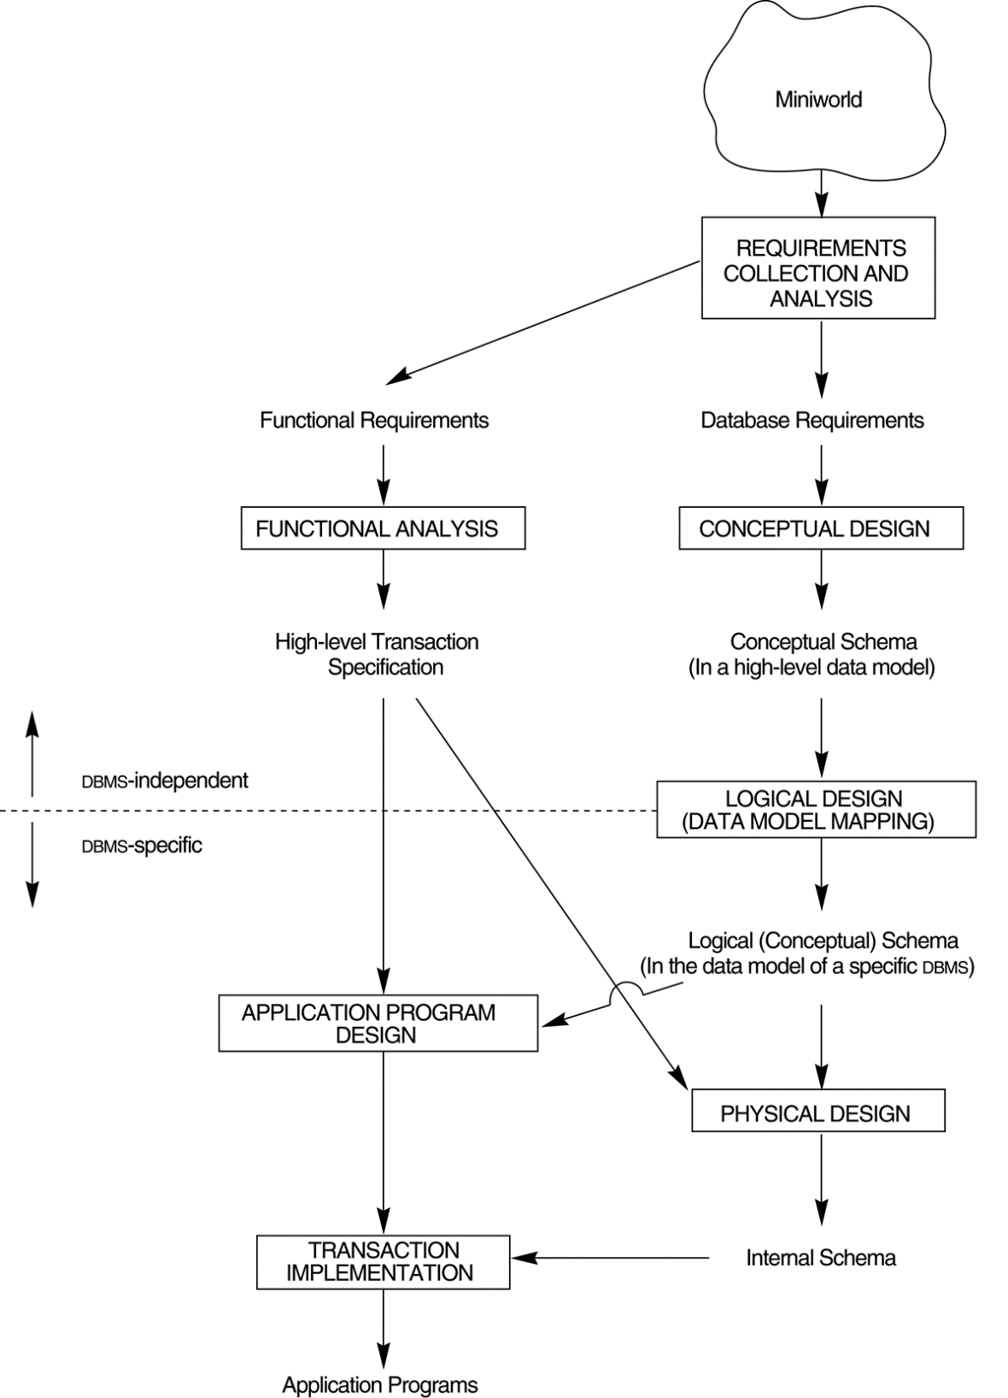
Main phases of database system design
Ch.7&8
(ER/EER)
Ch.3
(Relational)
Ch. 4&5 (SQL)
Construct DB
Design DB
Define DB
Load DB
Mini-world
DB
DBMS

Slide 3
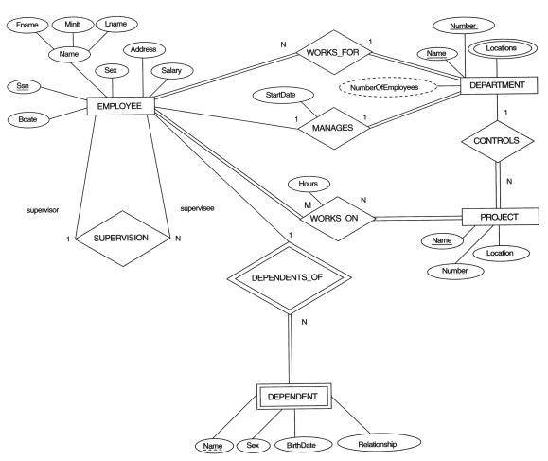
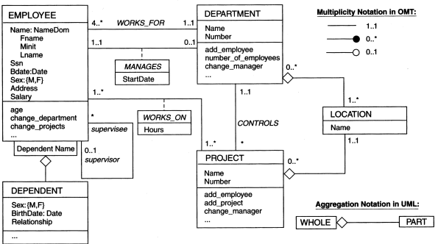
Conceptual Database Design
Ch.7&8
(ER/EER)
Entity
Attribute
Relationship
…
(data model)
ER or OO
ER diagram
Mini-world
Conceptual design
?
class diagram
Conceptual DB Schema
(DB structure)

Slide 4
Logical Database Design
(data model)
Relational
Ch.3
ER diagram
Logical design
Ch.8
Relational DB Schema
(DB structure)
class diagram

Slide 5
Chapter Outline
Relational Model Concepts
Informal definitions
Formal definitions
Characteristics of relations
Relational Model Constraints and Relational Database Schemas
Update Operations and Dealing with Constraint Violations

Slide 6
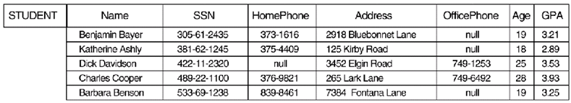
Relational Model Concepts
First proposed by Dr. E.F. Codd of IBM in Communications of the ACM, June 1970:
A Relational Model for Large Shared Data Banks
The paper caused a major revolution in the field of Database management and earned Ted Codd the coveted ACM Turing Award.
The Relational Model of Data is based on the concept of a Relation.
A Relation is a mathematical concept based on the ideas of sets.
The strength of the relational approach to data management comes from the formal foundation provided by the theory of relations.
A Relation

Slide 7
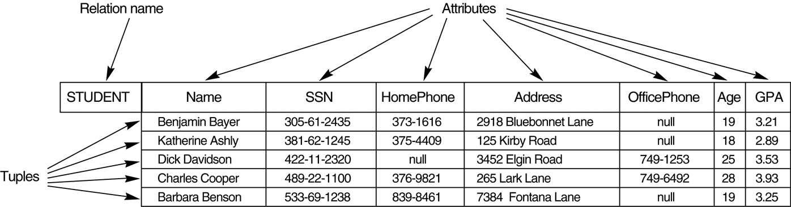
INFORMAL DEFINITIONS
RELATION: A table of values
A Relation may be defined in multiple ways.
A relation may be thought of as a set of rows.
A relation may alternately be though of as a set of columns.
Each row represents a fact that corresponds to a real-world entity or relationship.
Each row has a value of an item or set of items that uniquely identifies that row in the table.
Sometimes row-ids or sequential numbers are assigned to identify the rows in the table.
Table
Columns
Rows

Slide 8
FORMAL DEFINITIONS
The Schema of a Relation:
R(A1, A2, .....An)
STUDENT(Name, SSN, HomePhone, Address, OfficePhone, Age, GPA)
STUDENT is a relation defined over the seven attributes.
Each of which has a domain or a set of valid values.
The domain of HomePhone is 7 digit numbers.

Slide 9
FORMAL DEFINITIONS
A tuple is an ordered set of values.
Each value is derived from an appropriate domain.
Each row in the STUDENT table may be referred to as a tuple in the table and would consist of seven values.
<“Dick Davidson”, 422-11-2320, null, “3452 Elgin Road”, 749-1256, 25, 3.53>
is a tuple belonging to the STUDENT relation.
A relation may be regarded as a set of tuples (rows).
Columns in a table are also called attributes of the relation.

Slide 10
FORMAL DEFINITIONS
A domain D is a set of atomic (indivisible) values.
“Phone_numbers” are the set of 9 digit phone numbers valid in the U.S.
A domain may have a data-type or a format defined for it.
The Phone_numbers may have a format:
(dd)-ddd-dddd where each d is a decimal digit.
Dates have various formats such as
monthname, date, year or yyyy-mm-dd, or dd mm,yyyy etc.
An attribute designates the role played by the domain
the domain Date may be used to define attributes “Invoice-date” and “Payment-date”.
domain (Phone_numbers) =
{(00)-000-0001, (00)-000-0002, …, (99)-999-9998, (99)-999-9999}
…
Hours Int;
Tel_No Phone_numbers;
Bdate DATE;

Slide 11
Cartesian Product
Let dom(A1) = {0, 1}, dom(A2) = {a, b, c}
Cartesian product of dom(A1) and dom(A2)
dom(A1) × dom(A2)
= {<0,a> <0,b> <0,c> <1,a> <1,b> <1,c>}
Let dom(A1) = {0, 1} dom(A2) = {a, b, c} dom(A3) = {7, 8}
Cartesian product of dom(A1), dom(A2) and dom(A3)
dom(A1) × dom(A2) × dom(A3)
= {<0,a,7> <0,a,8> <0,b,7> <0,b,8> <0,c,7> <0,c,8>
<1,a,7> <1,a,8> <1,b,7> <1,b,8> <1,c,7> <1,c,8>}
No. of Cartesian product result
|dom(A1)| × … × |dom(An)|

Slide 12

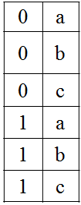
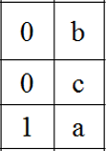
Relation and Cartesian Product
R
Give a relation r(R) over A1 and A2, then
r(R) ⊆ dom(A1) × dom(A2)
Let dom(A1) = {0, 1}, dom(A2) = {a, b, c}
r(R) ⊆ dom(A1) × dom(A2)
= {<0,a> <0,b> <0,c> <1,a> <1,b> <1,c>}
E.g.: r(R) = {<0,b> <0,c> <1,a> }
is one possible “state” or “population” or “extension” r of the relation R, defined over domains A1 and A2. It has three tuples.
No. of Cartesian product result, or maximum size of r(R):
|dom(A1)| × |dom(A2)|
r(R)
R
r(R)

Slide 13
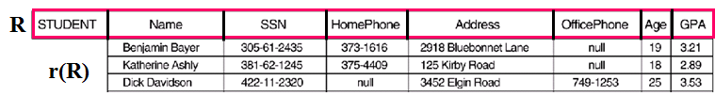
FORMAL DEFINITIONS
The relation is formed over the Cartesian product of the sets; each set has values from a domain; that domain is used in a specific role which is conveyed by the attribute name.
Attribute Name is defined over the domain of strings of 25 characters. The role these strings play in the STUDENT relation is that of the name of students.
Formally,
Given R(A₁, A₂, .........., A_{n})
r(R) ⊆ dom (A₁) × dom (A₂) × .... × dom(A_{n})
where
R: schema of the relation . (also called the intension of a relation)
r of R: a specific "value" or population of R. (also called the extension)

Slide 14
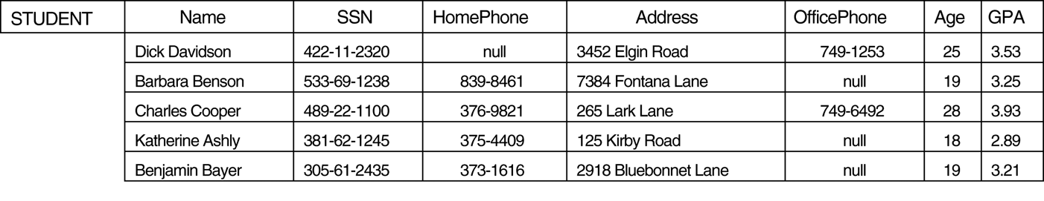
DEFINITION SUMMARY
Informal Terms |  | Formal Terms
Table |  | Relation
Column |  | Attribute/Domain
Row |  | Tuple
Values in a column |  | Domain
Table Definition |  | Schema of a Relation
Populated Table |  | Extension

Slide 15
CHARACTERISTICS OF RELATIONS
Ordering of tuples in a relation r(R):
not considered to be ordered, even though they appear to be in the tabular form.
Ordering of attributes in a relation schema R (and of values within each tuple):
We will consider the attributes in R(A₁, A₂, ..., A_{n}) and the values in t = <v₁, v₂, ..., v_{n}> to be ordered .
However, a more general alternative definition of relation does not require this ordering, i.e., t = <A₂:v₂, A₁:v₁, …A_{n}:v_{n}>
Values in a tuple:
considered atomic (indivisible).
A special null value is used to represent values that are unknown or inapplicable to certain tuples.

Slide 16
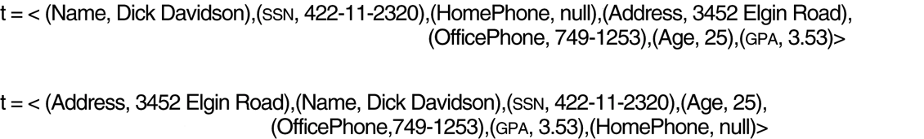
FIGURE 5.3 Two identical tuples when the order of attributes and values is not part of relation definition.

Slide 17
CHARACTERISTICS OF RELATIONS
Notation
We refer to component values of a tuple t by
t[A_{i}] = v_{i} (the value of attribute A_{i} for tuple t).
Similarly, t[A_{u}, A_{v}, ..., A_{w}]
refers to the subtuple of t containing the values of attributes A_{u}, A_{v}, ..., A_{w}, respectively.
t
t[Name] = [Benjamin Bayer]
t[SSN, Name, Age] = [305-61-2435, Benjamin Bayer, 19]

Slide 18
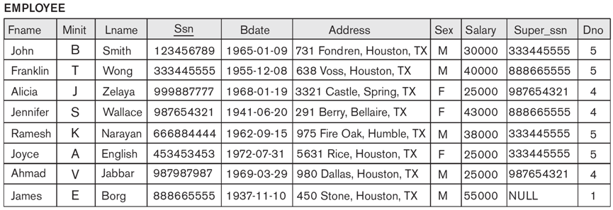
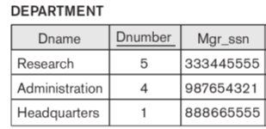
Relational Integrity Constraints
Constraints are conditions that must hold on all valid relation instances.
There are three main types of constraints:
Key constraints
Entity integrity constraints
Referential integrity constraints
DB
valid
Can John’s Ssn be 333445555? Or be NULL?
Can John’s Dno be 7?

Slide 19
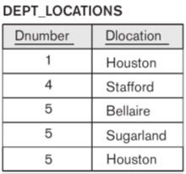
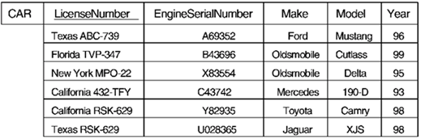
Key Constraints
Superkey of R:
A set of attributes SK of R such that no two tuples in any valid relation instance r(R) will have the same value for SK.
For any distinct tuples t1 and t2 in r(R), t1[SK] ≠ t2[SK].
SK={LicenseNumber}?, SK={Make}?, SK={LicenseNumber, Make}?
Key of R:
A "minimal" superkey;
A superkey K such that removal of any attribute from K results in a set of attributes that is not a superkey.
Key1 = {LicenseNumber}, Key2 = {EngineSerialNumber}
are two keys of relation CAR; Key = {Dnumber, Dlocation}
SK1={EngineSerialNumber, Make}, SK2={LicenseNumber, Make, Year}
are superkeys but not keys
t1
t2

Slide 20
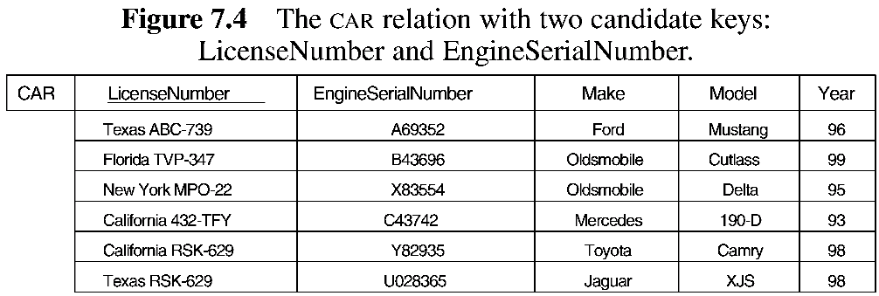
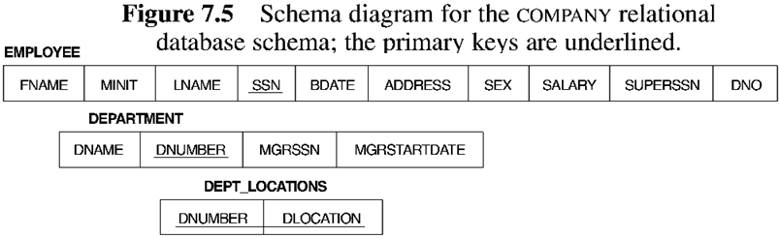
Candidate keys and Primary key
If a relation has several candidate keys, one is chosen arbitrarily to be the primary key. The primary key attributes are underlined.
Superkey
Key
Candidate key
Primary key

Slide 21
Superkey
Key
Candidate key
Primary key
What is the primary key of EMPLOYEE?
Is {Fname, Address} a superkey of EMPLOYEE? A key?
Is {Dnumber, Mgr_ssn} a superkey key of DEPARTMENT? A key?

Slide 22
Superkey
Key
Candidate key
Primary key

Slide 23
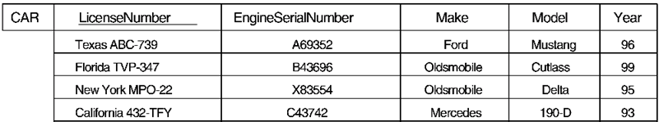
Entity Integrity
Relational Database Schema:
A set S of relation schemas that belong to the same database. S is the name of the database.
S = {R₁, R₂, ..., R_{n}}
Entity Integrity:
The primary key attributes PK of each relation schema R in S cannot have null values in any tuple of r(R).
t[PK] ≠ null for any tuple t in r(R)
This is because primary key values are used to identify the individual tuples.
Note: Other attributes of R may be similarly constrained to disallow null values, even though they are not members of the primary key.
NULL
?

Slide 24
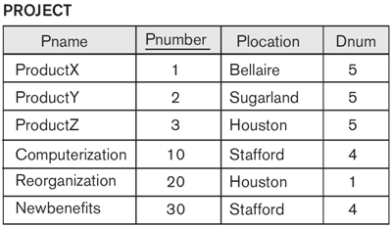
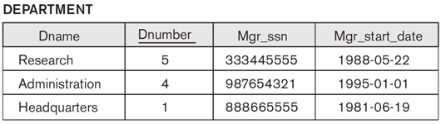
Referential Integrity
A constraint involving two relations (the previous constraints involve a single relation).
Tuples in the referencing relation R₁ have attributes FK (called foreign key attributes) that reference the primary key attributes PK of the referenced relation R₂.
A tuple t₁ in R₁ is said to reference a tuple t₂ in R₂ if t₁[FK] = t₂[PK].
DEPARTMENT
DNAME | DNUMBER | MGRSSN | STRDATE
(R₂) referenced
PROJECT
PNAME | PNUM | PLOCATION | DNUM
(R₁) referencing
(FK)
Can Reorganization’s Dnum be 7 in PROJECT?
Can Reorganization’s Dnum be NULL?

Slide 25
Referential Integrity Constraint
Referential Integrity Constraint
The value in the foreign key column (or columns) FK of the referencing relation R₁ can be either:
a value of an existing primary key value of the corresponding primary key PK in the referenced relation R_{2,}, or
a null.
In case (2), the FK in R₁ should not be a part of its own primary key.
(PK)
(R₂) referenced
DEPARTMENT
DNAME | DNUMBER | MGRSSN | STRDATE
PROJECT
PNAME | PNUM | PLOCATION | DNUM
(R₁) referencing
(FK)
A referential integrity constraint can be displayed in a relational database schema as a directed arc from R₁.FK to R₂.PK.

Slide 26
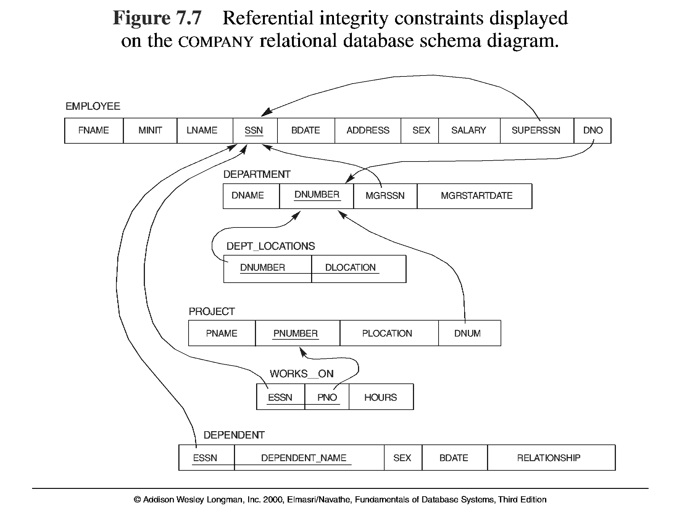
5.7
PK
FK
PK?FK?
FK

Slide 27
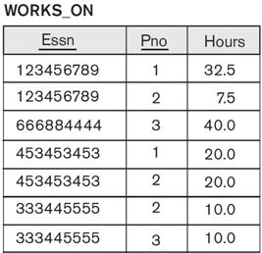
Other Types of Constraints
Semantic Integrity Constraints:
based on application semantics and cannot be expressed by the model per se
“the maximum number of hours per employee for all projects he or she works on is 56 hrs per week”
A constraint specification language may have to be used to express these.
SQL-99 allows triggers and ASSERTIONS to allow for some of these
Can the following constraints express the above constraint?
Key constraints
Entity integrity constraints
Referential integrity constraints

Slide 28

Update Operations on Relations
Update operations
INSERT a tuple.
DELETE a tuple.
MODIFY a tuple.
Integrity constraints should not be violated by the update operations.
Updates may propagate to cause other updates automatically. This may be necessary to maintain integrity constraints.
Key constraints
Entity integrity constraints
Referential integrity constraints

Slide 29
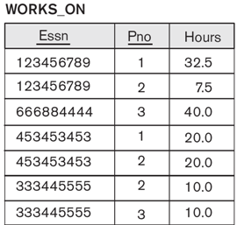
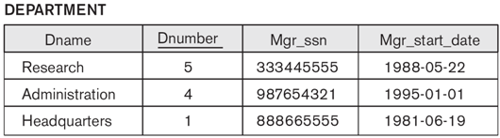
Update Examples
1. Update the DNO of the EMPLOYEE ‘999887777’ TO 7
(PK)
(FK)
(FK)
Update
(PK)
(FK)
Key constraints
Entity integrity constraints
Referential integrity constraints (FK→PK)
(FK)
(FK)

Slide 30
Update Examples
2. Delete the EMPLOYEE tuple with SSN=‘333445555’
(PK)
(FK)
(FK)
Delete
(PK)
(FK)
Key constraints
Entity integrity constraints
Referential integrity constraints (FK→PK)
(FK)
(FK)

Slide 31
Update Examples
3. Update the SALARY of the EMPLOYEE tuple with SSN=‘888665555’ to 60000.
4. Delete the WORKS_ON tuple with ESSN=‘123456789’ and PNO=1.
4.
3. Modify to 60000
4. Delete
Key constraints
Entity integrity constraints
Referential integrity constraints (FK→PK)

Slide 32
Update Operations on Relations
In case of integrity violation, several actions can be taken:
Cancel the operation that causes the violation (REJECT option)
Perform the operation but inform the user of the violation
Trigger additional updates so the violation is corrected (CASCADE option, SET NULL option, SET DEFAULT option)
Execute a user-specified error-correction routine
(PK)
(FK)
(FK)
Delete
Modify
(PK)
(FK)
(FK)
(FK)

Slide 33
In-Class Exercise
(Taken from Exercise in the textbook)
Consider the following relations for a database that keeps track of student enrollment in courses and the books adopted for each course:
STUDENT(SSN, Name, Major, Bdate)
COURSE(Course#, Cname, Dept)
ENROLL(SSN, Course#, Quarter, Grade)
BOOK_ADOPTION(Course#, Quarter, Book_ISBN)
TEXT(Book_ISBN, Book_Title, Publisher, Author)
Draw a relational schema diagram specifying the foreign keys for this schema.

